Slide 1
Connecting to the Raspberry Pi

Slide 2
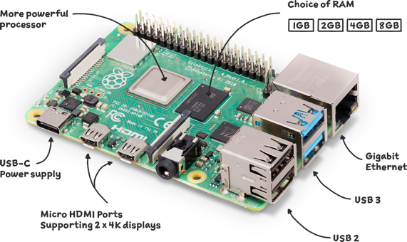
What is the Raspberry Pi?
The Raspberry Pi is a system on a chip (SOC) computer that runs a version of Linux called Raspbian
There are lots of different use cases for a Raspberry Pi; from controlling LED’s or a digital clock through the GPIO pins, to replacing a traditional computer, and even running trained Machine Learning models

Slide 3
Connect to the Raspberry Pi
Plug in a USB-C power supply.
If a network is not created by the pi make sure to also plug in an Ethernet cable

Slide 4
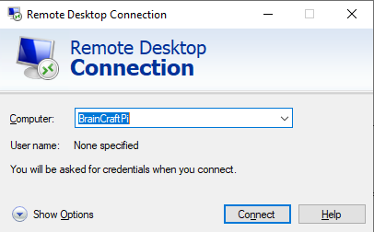
Connect to the Raspberry Pi
Launch the Remote Desktop Connection application on your computer

Slide 5
Connect to the Raspberry Pi
Type the name of your Raspberry Pi into the text box where it says ‘Computer’

Slide 6
Connect to the Raspberry Pi
Click “Connect”
If the connection does not work, try <computer_name>.local
For example, bcpi-001.local

Slide 7
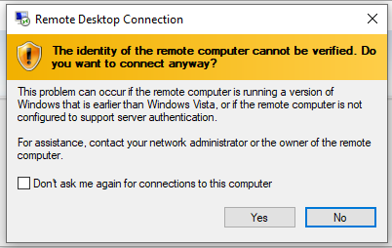
Connecting to the Raspberry Pi
If you get this pop up after clicking Connect, click the box next to “Don’t ask me again for connections to this computer” and then click Yes

Slide 8
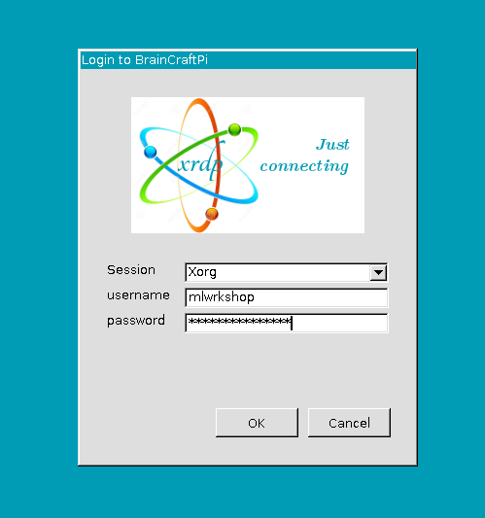
Connecting to the Raspberry Pi
Enter the login information to the pi
User Information
Username: workshop
Password: ml4hst2023
Root information
Username: pi
Password: raspberry

